Slide 1


Slide 2
Rationale Statement
This project seeks to create a Logistic Regression model and associated ROC/AUC curve for Mr. John Highes’ MHR dataset in order to forecast risk level
The dataset consists of 1014 observations and 7 variables that information about student performance.
Independent Variables:
Age: : Any ages in years when a women during pregnant
Systolic BP: Upper value of Blood Pressure in mmHg, another significant attribute during pregnancy
Diastolic BP: Lower value of Blood Pressure in mmHg, another significant attribute during pregnancy
BS: student’s forecasted score based on current math knowledge
BodyTemp: Body Temperature in Fahrenheit
HeartRate: A normal resting heart rate in beats per minute
Dependent Variable:
Risk Level: Predicted Risk Intensity Level (High Level, Mid Level, Low Level)
The goal is to train a forecast model that can learn the patterns and relationships between these independent features and the predicted Risk Intensity level.
By leveraging the Multinomial Logistic Regression, we aim to produce a model to use in predicting the Risk level from patients data.

Slide 3
Rationale Statement
Multinomial Logistic Regression
A multinomial logistic regression (or multinomial regression for short) is used when the outcome variable being predicted is nominal and has more than two categories that do not have a given rank or order. This model can be used with any number of independent variables that are categorical or continuous.
Assumptions
Independence of observations
Categories of the outcome variable must be mutually exclusive and exhaustive
No multicollinearity between independent variables
Linear relationship between continuous variables and the logit transformation of the outcome variable
No outliers or highly influential points

Slide 4
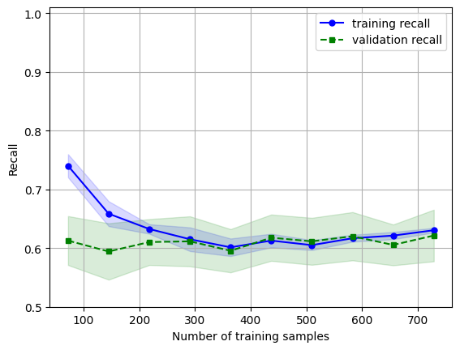
Learning Curve for Classification: Interpretation
The errors in the training recall is decreasing:
Indicates underfitting
High bias
Validation recall is majorly stagnant throughout:
Unable to learn from data
High errors
Should tweak model (perhaps increase model complexity) or decrease regularization
The training and validation curves are converging, adding more training data instances is very unlikely to help here.

Slide 5
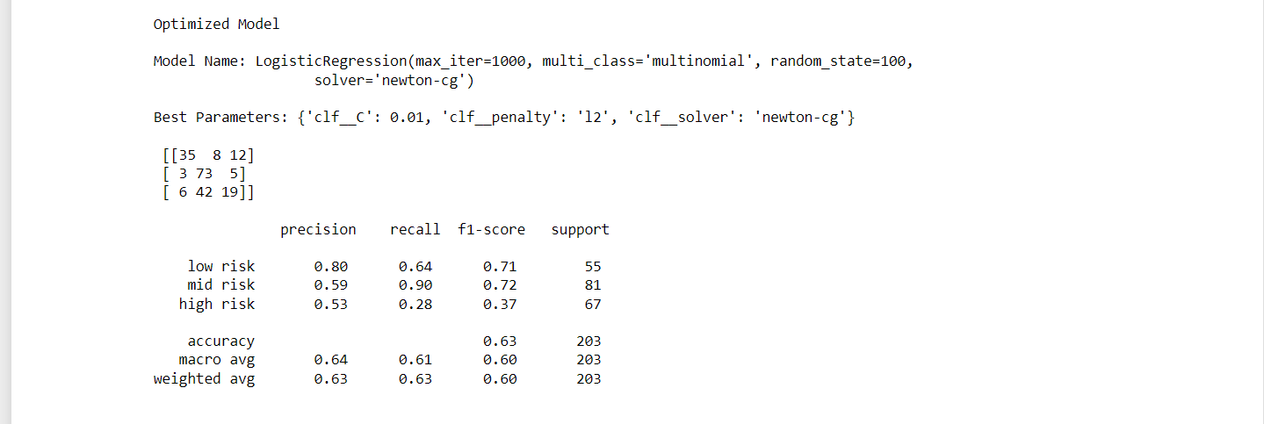
Confusion Matrix/Classification Report
Precision: The precision (performance metric) of the model for the “low risk" level is 0.80, on the “mid risk” level it is 0.59 while for the “high risk" class, it is 0.53
This indicates that the model has a high ability to correctly identify low risk level while mid risk and high risk still produces a considerable amount of false positive
Recall: The ‘mid risk’ level has the highest proportion of actual positives which were correctly classified. The proportion of the models which produced false negatives for ‘high risk’ level is relatively large.
F1-Score: With very similar values, the low risk and mid risk model show a greater glean to a perfect model than the combination of precision and recall – F1 score of the high risk at 0.28
Accuracy: Our model is only making predictions right 63% of the time
Support: The number of metrics are quite closely split
Because our classes are relatively balanced that’s why our Macro Avg and Weighted avg are quite similar.
Macro Avg and weighted avg are the average precision and weighted average precision of precision, recall and F1 score.
*weighted average favors the majority class.
Confusion Matrix – From the heat map, Systolic Bp and Diastolic BP have a high correlation up to 0.75

Slide 6
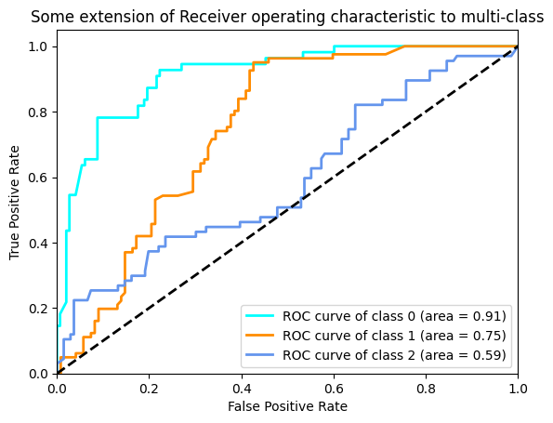
Evaluating the ROC/AUC curve
ROC & AUC curve Interpretation:
The model is doing better than the guess model (black dotted line; ROC of any random classifier) by ‘class 0’ 0.91, ‘class 1’ 0.75, ‘class 2’ 0.59 AUC
The ROC curve compares the False Positive rate versus the True Positive rate.
The ROC Curve is based on different p-values. Generally, the closer the ROC is to the top right corner the better.
The ROC curve has no cross overs and shows the models are performing well.

Slide 7
Recommendations
Precision and Recall are valuable – considering the MHR (Medical Health record), the model is very critical we want higher True Positive Rate, and low False Positive rate.
From our ROC and AUC curve, we can get the overall best model by targeting a higher value on our y-axis (True positive). However, other threshold values can still be considered.
Considering we don’t have a large class imbalance, we can consider Accuracy has an indicator metric.

